Slide 1
Dive into
Apache Geronimo 3.0
Xu Haihong
Apache Geronimo PMC
xuhaihong@apache.com
2010-08-16

Slide 2
Agenda
Apache Geronimo History
Apache Geronimo Architecture
Apache Geronimo 3.0 New Features
Apache Geronimo Outlook
Q&A

Slide 3

What Is Apache Geronimo
[Don't] think of Geronimo as just another J2EE server
but as the start of a system framework that can be used to build a whole variety of tailored infrastructure services.
Jeremy Boynes,
principal founder of Gluecode Software

Slide 4
Apache Geronimo History
Apache Geronimo Project formed
V1.0-M5 released, J2EE 1.4 certification
V2.0-M6 released, Java EE 5 certification
…
…
V2.1 Released
V2.2 Released
V 3.0 Web Profile M1 Released
V 3.0 Web Profile
3.* Full Profile
August
2003
Oct
2005
…
Jun
2007
…
Feb
2008
Dec
2009
Jun
2010
Ongoing

Slide 5
Apache Geronimo Status
2.1.* Branch
  Java EE 5 Certified
  Apache Geronimo 2.1.6
2.2.* Branch
  Java EE 5 Certified
  Apache Geronimo 2.2.0
Trunk
  Java EE 6 Certified is ongoing !
  Apache Geronimo 3.0-SNAPSHOT (Under active development)

Slide 6
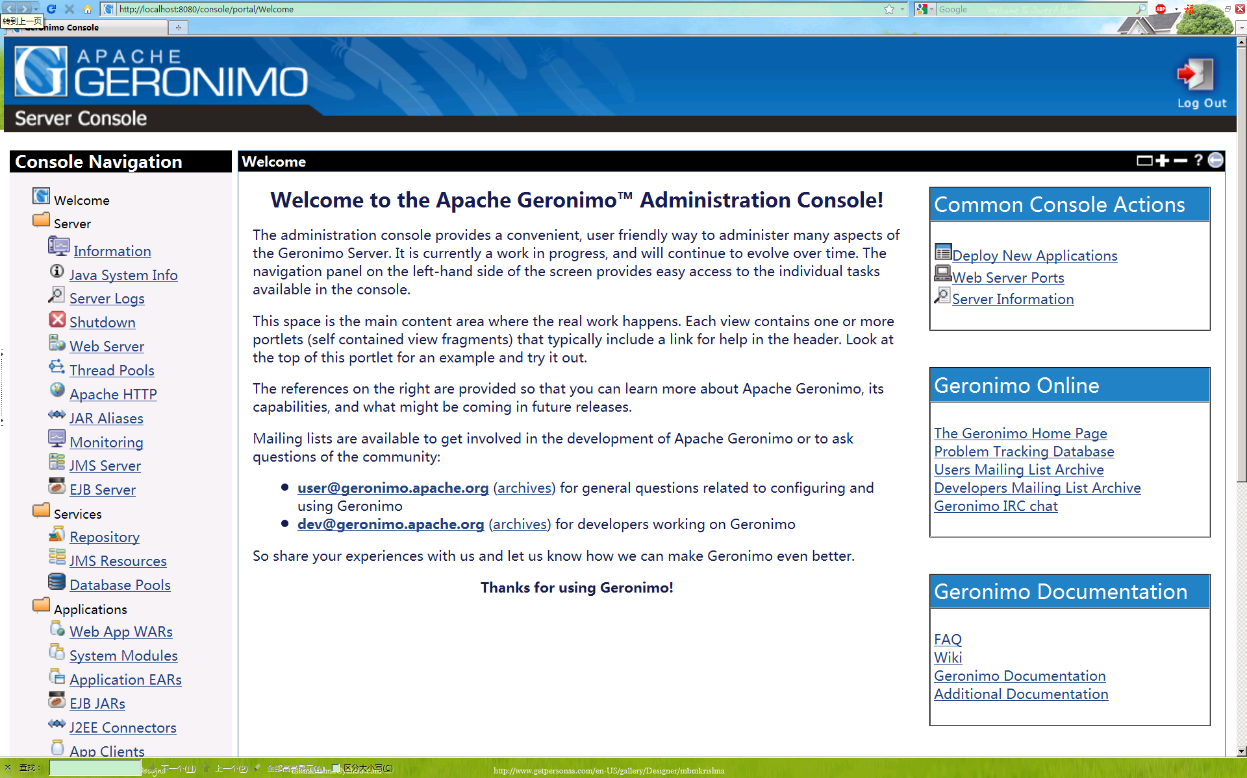
Apache Geronimo Admin Console

Slide 7
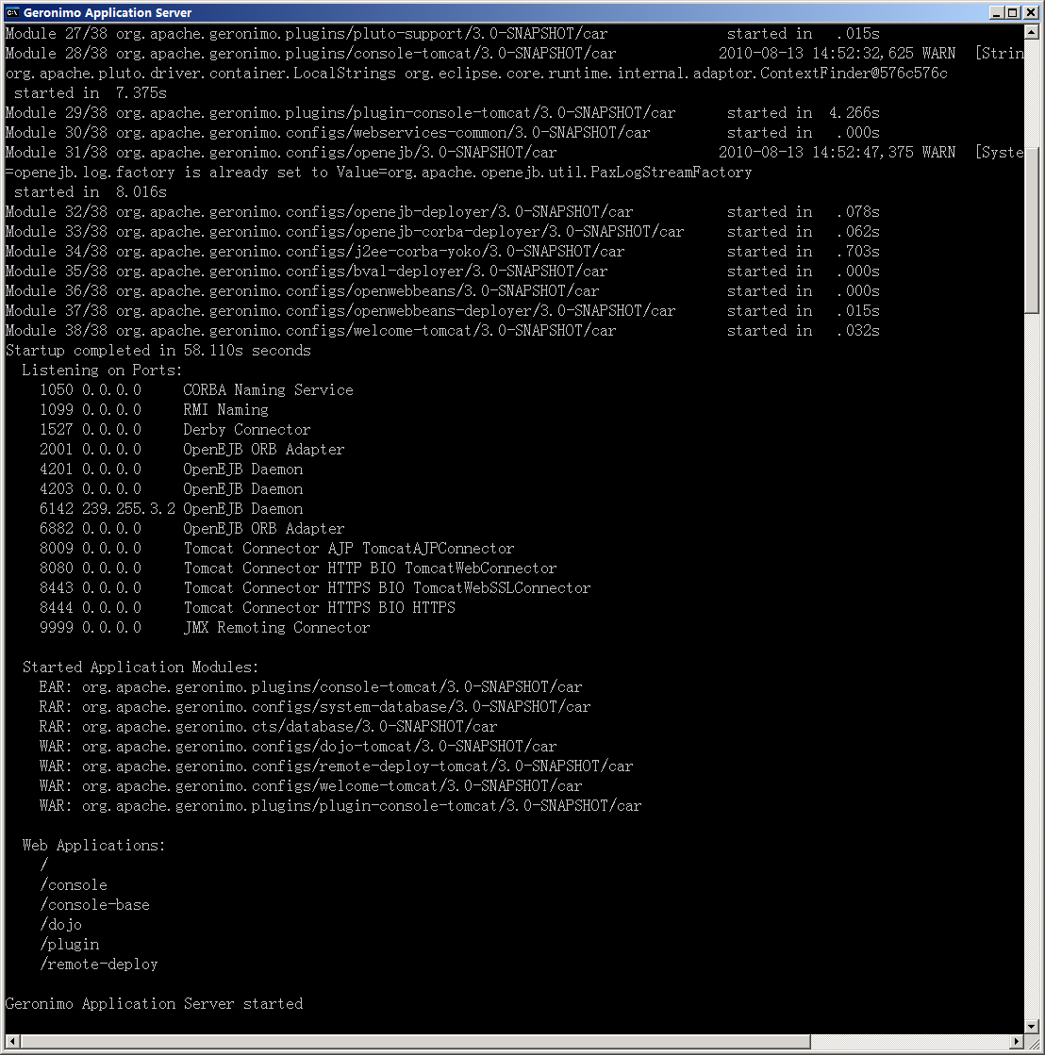
Apache Geronimo Console

Slide 8
Agenda
Apache Geronimo History
Apache Geronimo Architecture
Apache Geronimo 3.0
  Architecture
  New features
Apache Geronimo Outlook
Q&A

Slide 9
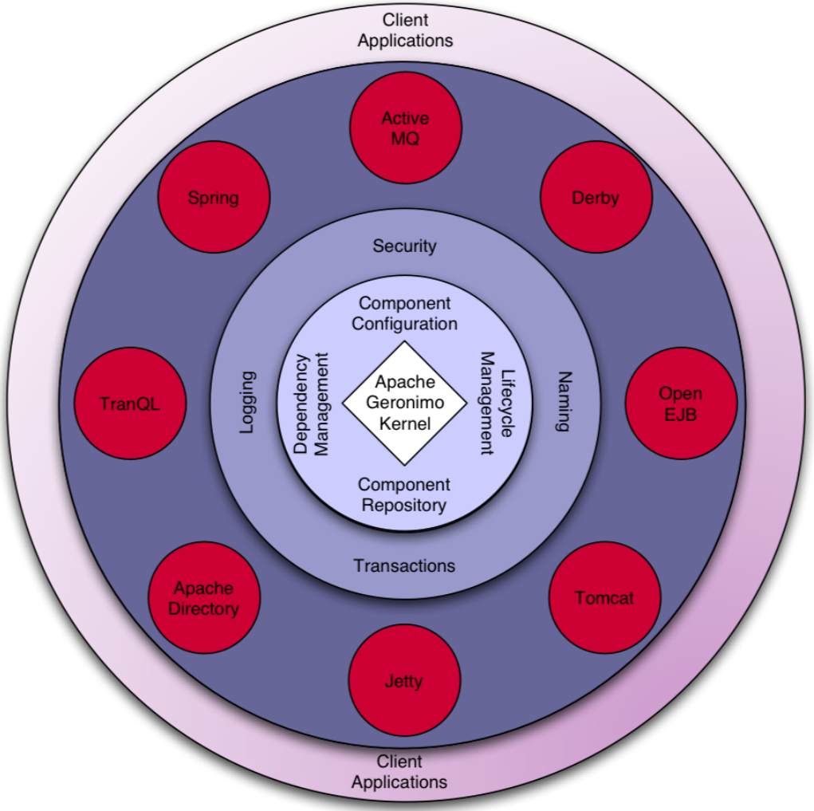
Geronimo Architecture Overview

Slide 10
Geronimo GBean Architecture
What is GBean ?
  A block ?
  A bond ?
Technically speaking
  A Simple Java Class
    May implement some lifecycle interfaces
    Declare attributes/methods/references
  Managed by Geronimo kernel ( IOC Container )
Geronimo Kernel vs Spring Container

Slide 11
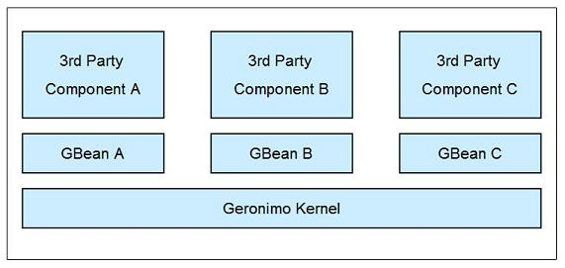
GBean Use Scenario : Adapter
Control the third-party components’ lifecycles
Configure and initialize third-party components
……

Slide 12
Integration GBean Sample
org.apache.geronimo.tomcat.HostGBean
  public class HostGBean extends … implements … {
    private final Host host;
    private final EngineGBean engine;
    public HostGBean(……) {
      host = (Host)Class.forName(className).newInstance();
      ……
    }
  public void doStart() {
  engine.addHost(host);
  }
  public void doStop() {
  engine.removeHost(host);
  }
  }

Slide 13
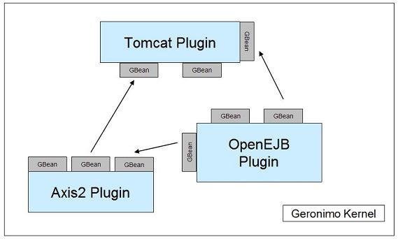
GBean Use Scenario : Service
One GBean could expose some services, and other GBeans could take advantage of them.

Slide 14
Service GBean Sample
org.apache.geronimo.tomcat.deployment. TomcatModuleBuilder
  public TomcatModuleBuilder(
    ......
    @ParamReference(name="WebServiceBuilder“,……) WebServiceBuilder webServiceBuilder
    ) {
    ……
    }
  public void addGBeans( …… ) {
    ……
    serviceBuilder.configurePOJO(servletData, servletName, module, servletClassName, moduleContext))
    ……
    }

Slide 15
Agenda
Apache Geronimo History
Apache Geronimo Architecture
Apache Geronimo 3.0 New features
  Java EE 6 Support
  OSGi Enablement
  EBA Support
Apache Geronimo Outlook
Q&A

Slide 16
Java EE 6 Support
Java EE 6 Spec was finally released in Dec 2009
Major components
  Servlet 3.0 -> Tomcat 7.0 / Jetty 8.0
  JSP 2.2 -> Jasper 7.0
  EJB 3.1 -> OpenEJB 3.2.*
  JAX-WS 2.2 -> Axis2 2.* / CXF 2.3.*
  Web Beans -> OpenWebBeans 1.*
  ……

Slide 17
OSGi Enablement
Geronimo 3.0 is totally based on OSGi
  All Geronimo components are bundles running in the OSGi environment
    Start Order now:
      Start OSGi runtime
      Start Apache Karaf
      Start Geronimo
  All the user applications will be running in the OSGi environment as bundles
  Support Apache Felix/Equinox OSGi runtime

Slide 18
What major changes bring by OSGi
Classloader Architecture Changes
  Past : Multi-parent Classloader
    One Classloader could have more than one parent classloaders
  Now : OSGi Bundle Classloader
    One Bundle/Jar One Classloader

Slide 19
Multi-parent Classloader Architecture
……
System/Application Classloader
JSF Classloader
JPA Classloader
WebService Classloader
Application A Classloader
Application C Classloader
Application B Classloader

Slide 20
Multi-parent Classloader
Disadvantage
  Complex Classloader Hierarchy Tree
    Classloader efficiency
  Classloader related Exception
    ClassNotFoundException
    LinkageError
    ClassCastException

Slide 21
OSGi Bundle Classloader
Tomcat Shared
Tomcat Util
…
Tomcat catalina
Tomcat Plugin
JAX-WS API
Annotation API
Jasper
Servlet API
JAXB API

Slide 22
OSGi Bundle Classloader
Import-Package/Export-Packages defines the mapping relation between different bundles, and improve the classloader efficiency
Usually, the same class loading request is routed to the same bundle

Slide 23
EBA Support
Enterprise Bundle Application
  Programming Model for developing, assembling and deploying, as OSGi bundles, modular applications that exploit Java EE and OSGi technologies.
Geronimo 3.0 integrates Apache Aries , and support EBA packages deployment.

Slide 24
Agenda
Apache Geronimo History
Apache Geronimo Architecture
Apache Geronimo 3.0 New features
Apache Geronimo Outlook
Q&A

Slide 25
Apache Geronimo Outlook
Integration Style Change
  Use the third-components’ initial configuration style
Take advantages of more OSGi functions
  Use OSGi for the underlying service provider, like JNDI etc.
  Use blueprint to “replace” GBean
Usability improvement
  Plan to re-organize Geronimo Admin Console
  Plan to add more pages for OSGi bundle management

Slide 26
Reference
Apache Geronimo
Apache Geronimo project resources

Slide 27
Q&A

Slide 28
Thank you !

